Slide 1
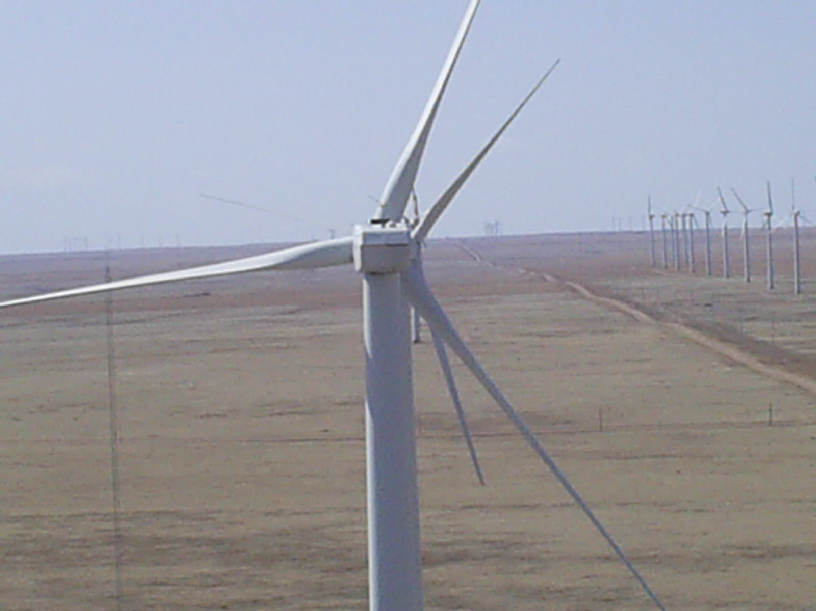
Global Leadership Through Renewable Energy
Stephen Shorkey
EMD 350V – M73

Slide 2
Introduction & Problem
The United States has an aging Energy infrastructure based on outdated technologies and programs designed decades ago that have lead to an unstable power grid and questionable future sustainability.
Pollution levels in the atmosphere will continue to rise causing a possible climate catastrophe.
The current economic crisis in the United States has lead to widespread unemployment.

Slide 3
My Vision
Jobs
Environment
Sustainability
BENEFIT
Innovation
Commitment
Leadership &
Education
COST
By
Stephen Shorkey

Slide 4
Goals and Objectives
Redirect resources into renewable energy markets.
Commit to Money
Education
Technology
Invest at home. This means keeping our money here in the United States.
Commit to building up our energy infrastructure into a world-class system to be seen as a model by the world.
Wean ourselves off of fossil fuels.
Create an education system that promotes future technology and trains people to work in science.

Slide 5
Vision and Impact
I see the United States as having the potential to be a world leader in renewable energy.
We can set the standard in efficiency and in global environmental leadership.
We can create jobs managing wind, solar, and biomass facilities as well as building the equipment necessary to equip them by investing in our own future and not increasing the trade deficit.
We can create exports and rebalance the world economy with responsible investment in our own country.

Slide 6
Summary
Big changes need to happen in the United States with regards to money, education, financial stability and environmental controls.
Renewable Energy investments and commitments can be a major vehicle to help the county achieve a leadership status in this growing market.
The renewable energy market can also create a wealth of new jobs with the right leadership in place and with the drive to carry out the vision.

